Slide 1
INVESTMENT CASE STUDY SUBMISSION
Group Name:
Vivek Sachdeva
Vikash Sharma
Venkatesh Moorthi K
Rajashri Thakare

Slide 2
Business Goals
Identify ideal funding type as per Sparks fund requirements
Top Destinations to be identified for investments
Suitable sectors for investments in top destinations
Check for ideal investments based on preferred investment types by other investors
Identify top 9 English Speaking countries for ease of investment
Top main sectors to be identified based on categories, based on top destinations investment analysis

Slide 3
Problem Solving Methodology
Fetch all tables to R
Identify top 3 sectors for top 3 English speaking countries of investments
Is there any unique/primary column in rounds2 and companies
Yes
Yes
No
Does this fetch English speaking countries
No funding type is suitable
No English speaking country for suitable funding type
Convert all primary columns to lower case and rename them to same name
No
Arrange data by raised amount to summarize different funding types
Any funding type between $5 -15M
Yes
Align mapping (after long format) and companies sheet on categories (with upper case on column)
Arrange and summarize raised amount for different countries to identify top investment destinations
Merge rounds2 and companies table on primary column to create master_frame
Cleanup mapping data for 0

Slide 4
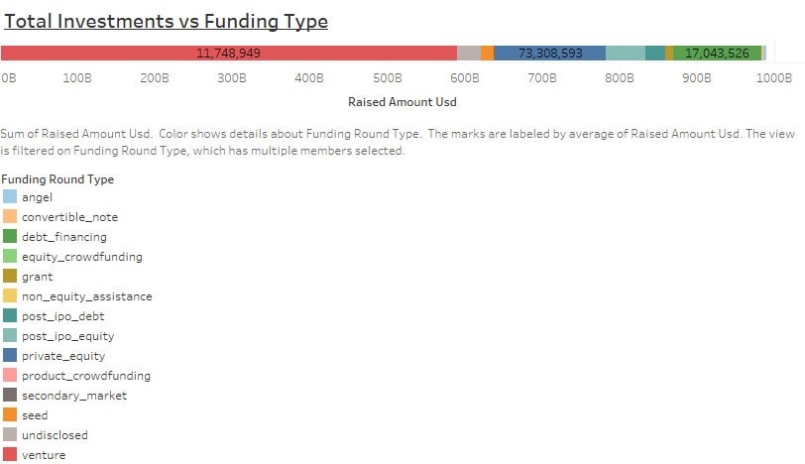
Funding types with Investments

Slide 5
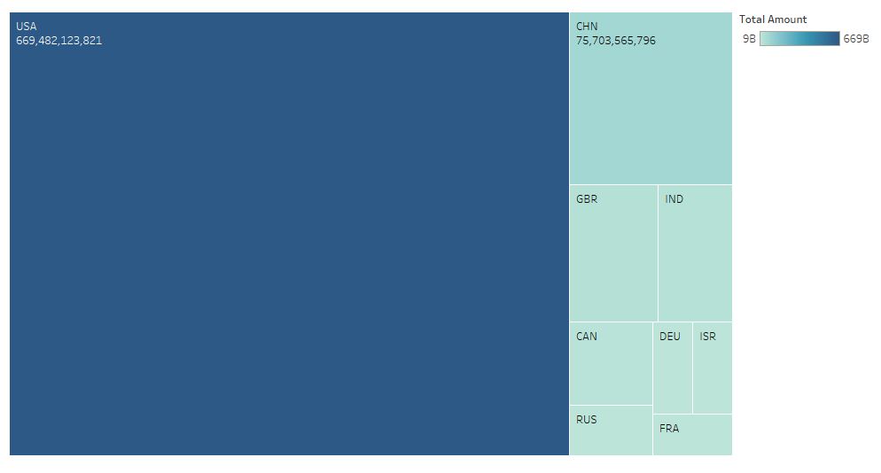
Investment Destinations across all funding types

Slide 6
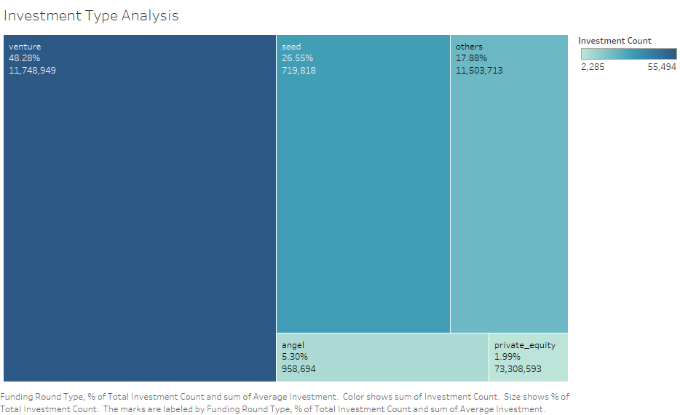
Plot 1 – Investment Type Analysis

Slide 7
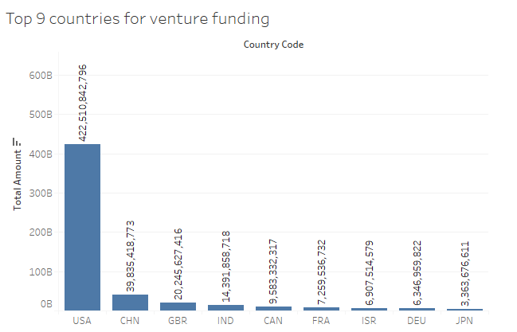
Plot 2 – Top 9 Investment Destinations Overall for venture funding

Slide 8
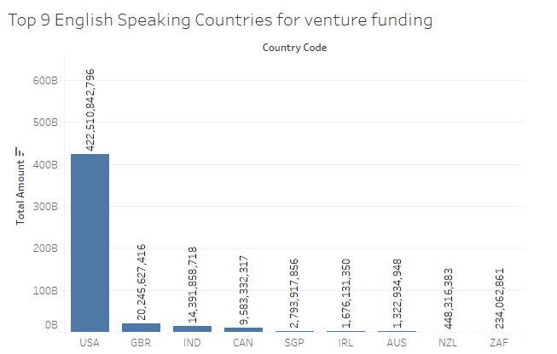
Plot 2 – Top 9 English speaking countries for Investment through venture funding

Slide 9
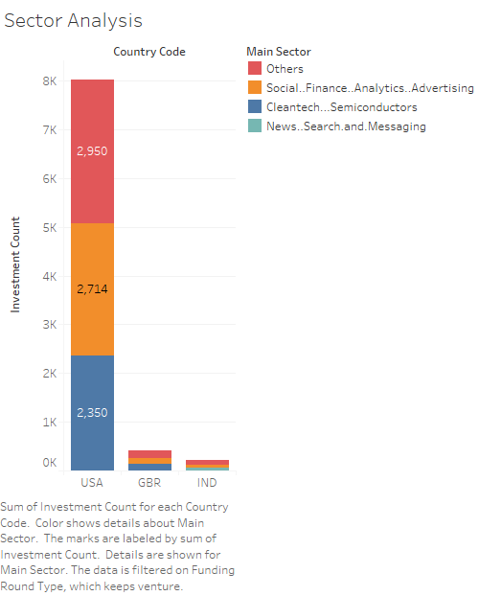
Plot 3 - Top 3 English Speaking Countries Sectoral Investment in venture funding

Slide 10
Investment Proposal for Spark Funds
Investment analysis
Venture funding is the most preferred type by investors. 48% of total investment goes in Venture funds
Ideal amount allocation for venture funds, with average investment ~ $12M in the venture funds
Top Countries for investments
US is the top most investment destination, followed by Britain and India in English speaking countries
US accounts 86% of total investment across countries, following by Britain as distant second with 5% of the total investments
Investment sectors
Top 3 sectors for investment in top 3 English Speaking countries are
Others
Social.Finance.Analytics.Advertising
Cleantech.semiconductors (except for India which has News, Search and Messaging)

